Slide 1

Journal of Solid-State Circuits
Author
ScholarOne Tutorial
P. Hanumolu
Editor-in-chief
August 2019

Slide 2
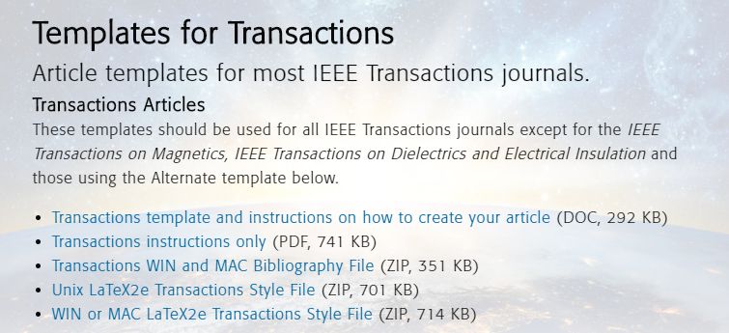
JSSC Manuscript Format
Use templates available at
  http://ieeeauthorcenter.ieee.org/create-your-ieee-article/use-authoring-tools-and-ieee-article-templates/ieee-article-templates/templates-for-transactions/
More information available at the IEEE author center
  http://ieeeauthorcenter.ieee.org/
For MS Word
For LaTeX

Slide 3
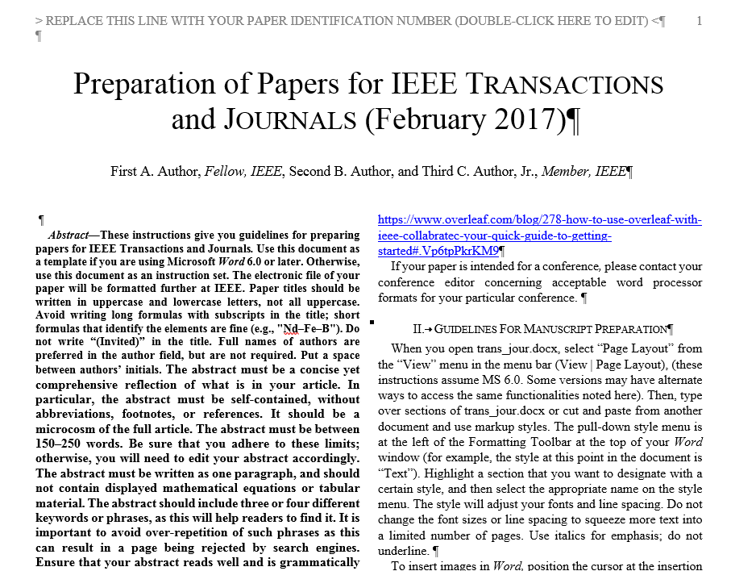

Slide 4
JSSC Manuscript Format
Double-column format as provided in the templates
Follow all instructions and guidelines as given in those templates
  Carefully worded abstract
  Define abbreviations and acronyms
  Equation style and units
  Figures and graphics
    Place figures at a relevant position in the text, not all at the end
  References
  Etc.
Only PDF files are allowed for initial manuscript review
  Tek/LaTex users: Embed all fonts in the PDF files

Slide 5
Manuscript Page Length
Regular papers: maximum 8 pages in length
    Includes title, abstract, all main text, figures, tables, footnotes, appendices, etc.
    References and bios are not included
    No modifications to e.g. font size or margins allowed
Longer papers are not necessarily better papers
  Please keep you manuscript concise and to the point, do not elaborate unnecessarily long on items of low importance
Exceptions
  If your topic does not allow you to report all required data in this page limit, an exception of up to 4 extra pages can be granted
  This must be properly motivated by the authors during the submission in a separate file
    With sufficient detail! “This is a big chip” is not sufficient
    Upload that file as a “Supplemental file for review”
  And is subject to approval by the Associate Editor
    The AE can refuse the exception, and request an 8-page submission
    The reviewers will also judge the necessity of the extra material

Slide 6
Manuscript Contents
The IEEE Journal of Solid-State Circuits publishes papers each month in the broad area of solid-state circuits with particular emphasis on transistor-level design of integrated circuits. It also provides coverage of topics such as circuit modeling, technology, systems design, layout, and testing in areas of central importance for circuit design.
The subject matter should therefore relate to the analysis, design, and performance of solid-state circuits. Integrated circuits and VLSI are of principal interest; material related to discrete circuit design is seldom published. Experimental verification is strongly encouraged.
Overview papers are generally not considered.

Slide 7
Manuscript Contents
Please refer to earlier published JSSC issues for the contents and style of a ‘typical’ paper
Clarity and clearness
  Authors are strongly encouraged to report on their work as openly and clearly as possible in their original manuscript submissions.
  The editors and reviewers understand that all aspects of the design presented are not always perfect, but hiding such items from the readers is always a reason for several revisions, and often even rejection.
  The solid-state circuits community will also learn from the less-than good aspects of the design presented, so authors are encouraged to present those as well.

Slide 8
Manuscript Title
Use a meaningful and quantitative title for your paper
Not too long, stating some key performance numbers
Avoiding words such as low(est), high(est), ...
NOT | RATHER
“A Low-Power ...” | “A 1mW ...”
“A Highly Linear ...” | “A +10 dBm IIP3 ...”
“A Linear ...” | “A 100 dB THD ...”
“A Revolution in ADC Design” | “A 1 GS/s 10 bit ADC”
Etc.

Slide 9
Pre-Publication Policy
Manuscripts that describe previously published material are certainly possible
  A typical example is an extended version of work published earlier at a conference
  Enough new material should be added to the JSSC submission, such that the paper would be interesting to read also for those who have read the conference paper
It is however IMPERATIVE to disclose ALL publications that are related to the work you are submitting to the JSSC
  Already published papers
  And papers submitted for review
A prepublication statement must be included in your submission
  Explaining the overlaps with and differences to the submitted manuscript for the convenience of the editor and the reviewers
  Including a pdf copy of the related publications

Slide 10
Pre-Publication Policy
ALL related papers should be disclosed
  Conference paper on the same IC
  Papers on an earlier version of your IC, on which this work builds further
  Papers that (shortly) describe the work submitted here, as part of another system
  Papers on (small) parts of the system described in this submission
  Etc.
Does not count as prepublication:
  Patents, preliminary datasheets, Ms/PhD thesis, etc.
Please consider this list carefully!
  An automated plagiarism check is performed on each submission and violations of this prepublication policy detected during the review process may result in a publication ban.

Slide 11
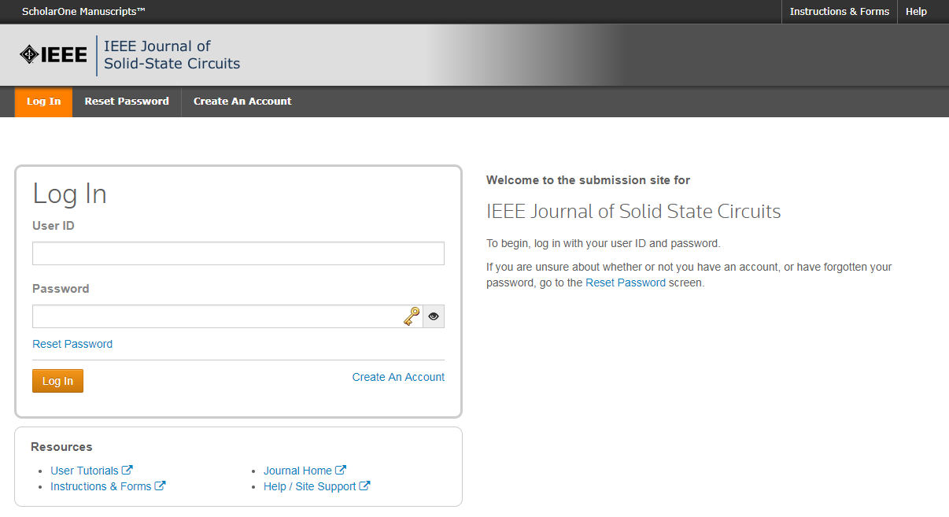
Manuscript Submission
Only electronic manuscript submission is possible
JSSC submission website:
http://mc.manuscriptcentral.com/jssc-ieee
Log in with an existing account, or create a new one
This is a dedicated (personal) account for the JSSC ScholarOne system, not your IEEE acccount

Slide 12
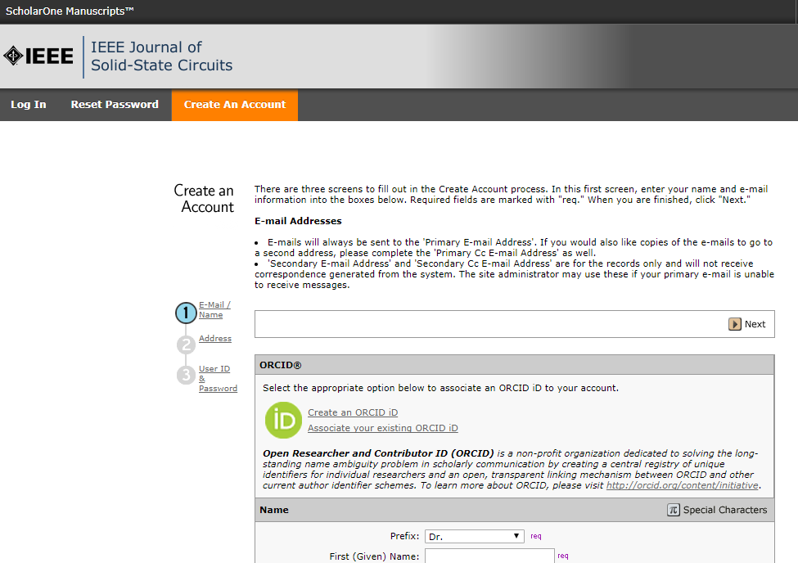
ORCID
ORCID (Open Researcher and Contributor ID) is required to submit a paper

Slide 13
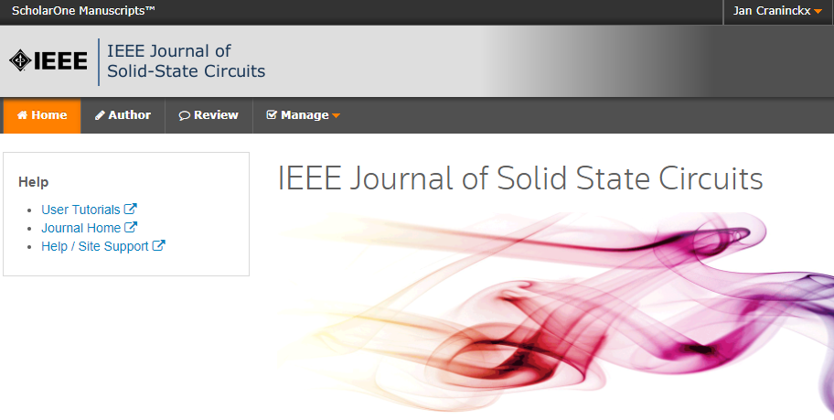
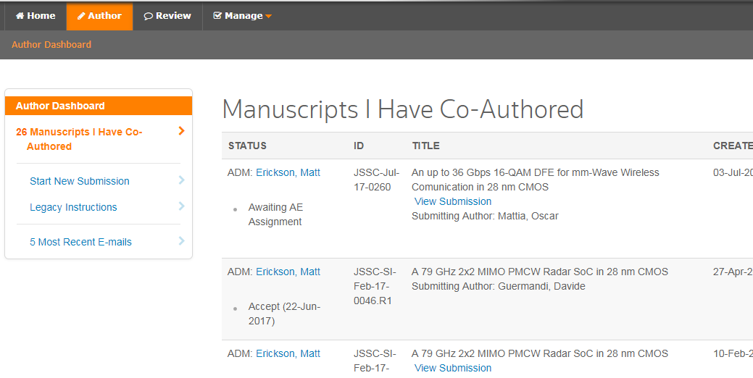


Author Center
Enter your
author center
Start a new submission

Slide 14
Six Steps to Submitting a Manuscript
Type, Title, & Abstract
Attributes
Authors & Institutions
Details & Comments
  Fully disclose any conflicts of interest
  Fully disclose prior related publications
File Upload
Review & Submit

Slide 15
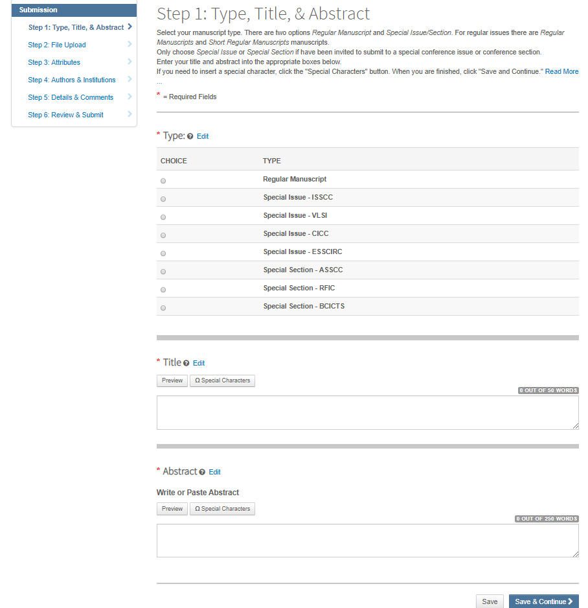
Regular manuscripts
ONLY for INVITED conference special issue or sections

Slide 16
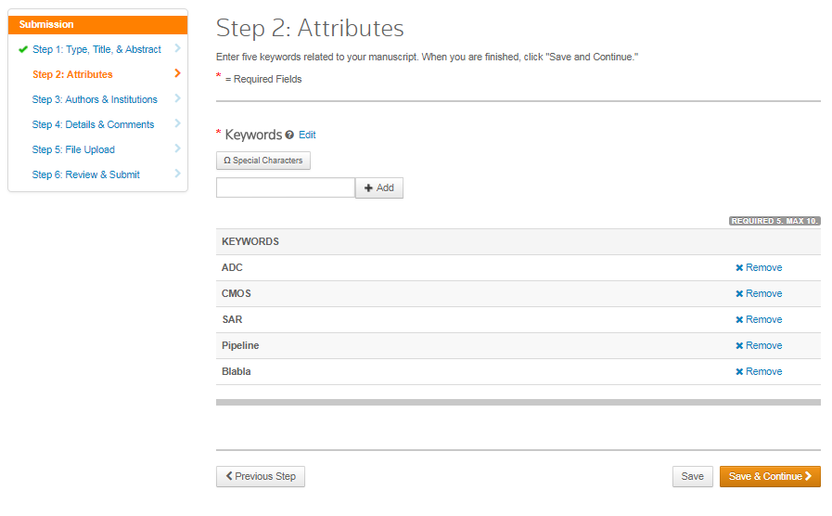
Add relevant keywords here
Only relevant keywords!

Slide 17
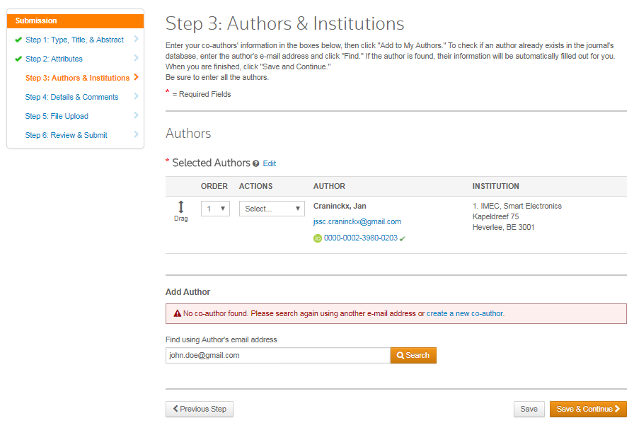
You are automatically the first author
(can be changed)
Add you co-authors
by searching with their
email address
If they do not have a ScholarOne account yet, create one for them
Please verify with them first, as they might be registered with a different email address, to avoid creating duplicate accounts in the system.

Slide 18
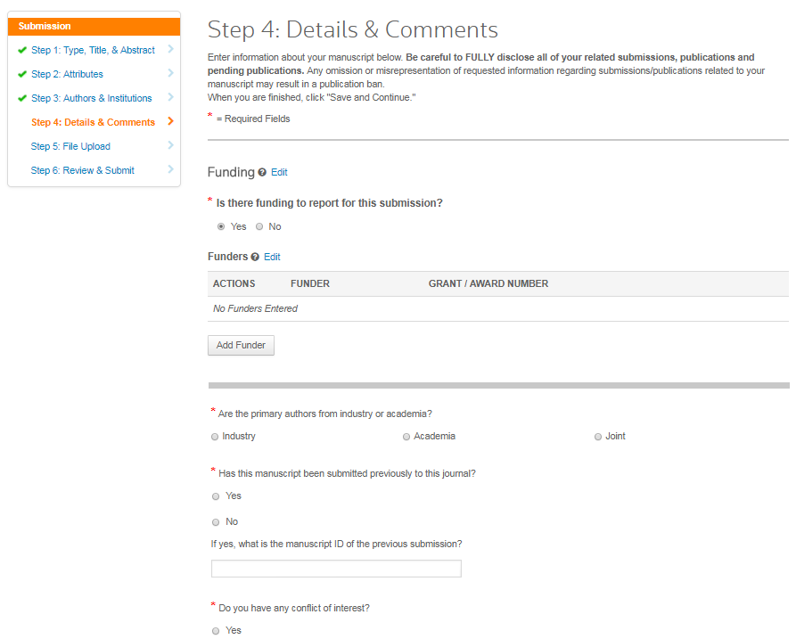
See special rules for
re-submissions of previously rejected manuscripts

Slide 19
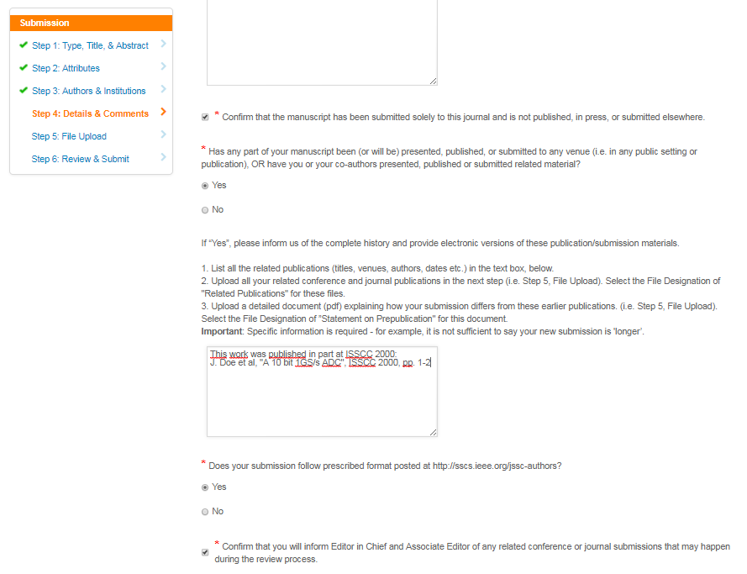
Very important!
See related slide on the JSSC prepublication policy
Fully disclose and attach all your related papers.
Prepare a prepublication statement explaining the overlaps and differences with the submitted paper, for evaluation by the editor and the reviewers.
Also very important!

Slide 20

Fully disclose ALL your related conference, journal, and book publications
Disclose any related submissions you make during the review process
See slides on the JSSC prepublication policy
Violations may result in a publication ban

Slide 21
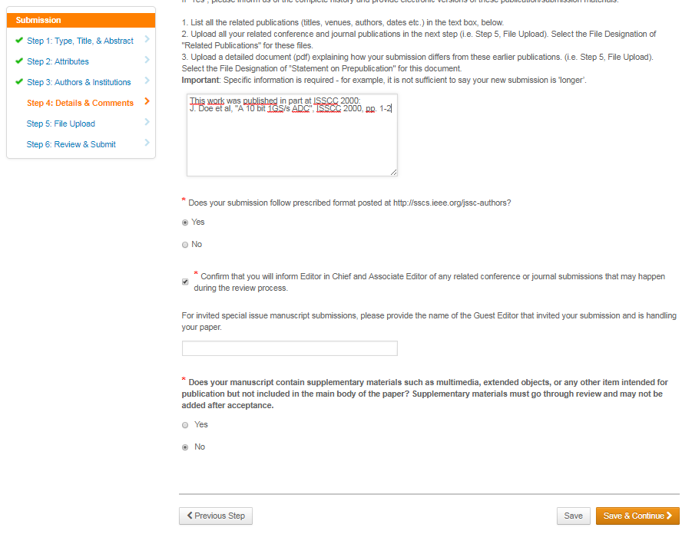
For invited papers only!
Add the name of the conference Guest Editor that has invited you.

Slide 22
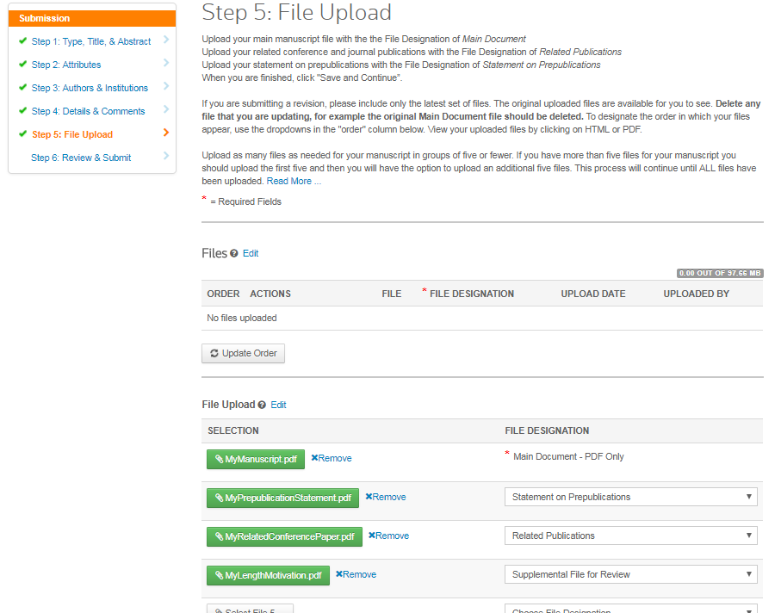
Your new manuscript - a PDF version created
from the MSWord or
LaTex template.
Don’t forget a copy of your related publications, and the prepublication statement.
If needed for overlength submissions.

Slide 23
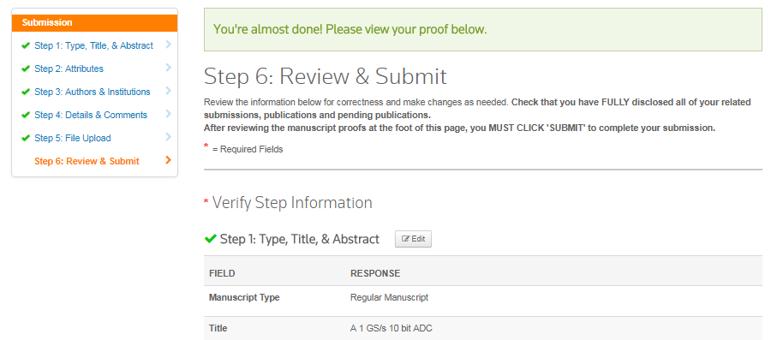
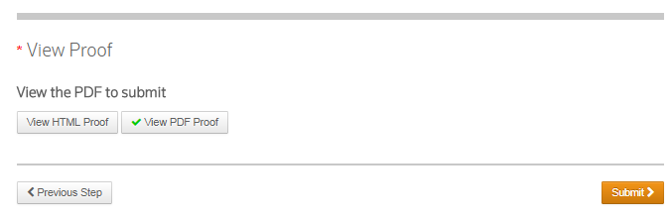
The last step, verify your inputs...
This is a combined PDF file with
cover page
Main manuscript
Prepublication statement
Related publications
And any other file you have submitted
Submit with this button

Slide 24
Confirmation email
Dear ####:
Your manuscript entitled "####" has been successfully submitted online and is presently being given full consideration for publication in the IEEE Journal of Solid-State Circuits.
Your manuscript ID is #### and the authors are: ####.
Please mention the above manuscript ID in all future correspondence. If there are any changes in your street address or e-mail address, please log in to ScholarOne Manuscripts at https://mc.manuscriptcentral.com/jssc-ieee and edit your user information as appropriate.
You can also view the status of your manuscript at any time by checking your Author Center after logging in to https://mc.manuscriptcentral.com/jssc-ieee.
IMPORTANT:
- Be sure that you have FULLY disclosed ALL your related publications and submissions
- Also let the Editor in Chief and your Associate or Guest Editor know of all related conference or journal submissions that you make during the JSSC review process
Please keep us informed of any changes to your disclosed submission/publication information. You are required to inform us if any part of your manuscript has been (or will be) presented, published, or submitted to any venue (i.e. in any public setting or publication). What is being requested here is transparency. Please disclose ALL related material. This includes any rejected JSSC submissions. Please provide electronic versions of the appropriate materials along with a brief description of how the present manuscript is different from the others.**
Thank you for submitting your manuscript to the IEEE Journal of Solid-State Circuits.
Sincerely,
IEEE Journal of Solid-State Circuits Editorial Administrator
jsscadmin@ieee.org

Slide 25
Manuscript assigned to Associate Editor
Dear ####,
Your manuscript is now being considered for publication.
Associate Editor, #### has been requested to supervise the review of your submitted manuscript "####".
To learn of progress on the reviews, you can email the Associate Editor directly at ####. Any email that concerns this submission should be composed and sent while you are connected to Manuscript Central at the site housing your paper. By doing this, a record is kept that is associated with the submitted manuscript. To correspond with ####, for example, simply click on the name when you are connected to the site in which your paper is stored. The system will then generate an email which you can alter. When you key on 'send,' the system stores a copy of the email.
If you find that there are changes that should be made in your manuscript, or in data (such as, for example, author contact information), please e-mail these changes to jsscadmin@ieee.org, with your AE in cc.
Thank you for submitting your paper to IEEE JSSC and our good wishes as it moves through the review phase.
Sincerely,
Dr. Jan Craninckx
jssc.craninckx@gmail.com
IEEE Journal of Solid State Circuits

Slide 26
Possible Review Decisions
Rejected
Major revisions required
Accepted pending Minor Revisions
Accepted

Slide 27
Case 1: Paper Rejected
In the case of a rejected paper, the author is notified by email

Slide 28
Case 2:
Revision required

Slide 29
Decision Letter
Dear ####:
Manuscript ID #### entitled "####" which you submitted to the IEEE Journal of Solid-State Circuits, has been reviewed.
The reviewers have required major revisions before publication could be considered.
## Comments from the Associate Editor ##
Detailed comments of the reviewer(s) are included at the bottom of this letter.
Therefore, I invite you to respond to the reviewers' comments and revise your manuscript. To revise your manuscript, log into https://mc.manuscriptcentral.com/jssc-ieee and enter your Author Center, where you will find your manuscript title listed under "Manuscripts with Decisions." Under "Actions," click on "Create a Revision." Your manuscript number has been appended to denote a revision.
You will be unable to make your revisions on the originally submitted version of the manuscript. Instead, revise your manuscript using a word processing program and save it on your computer. Once the revised manuscript is prepared, you can upload it and submit it through your Author Center.
IMPORTANT:
1) When submitting your revised manuscript, you should respond to EACH and ALL of the comments made by the reviewers in the space provided. You should also use this space to document any changes you make to the original manuscript. Be as specific as possible in your responses to the reviewers.
2) Please also highlight the changes to your manuscript within the document by using bold or colored text.
3) Do not put your responses to reviewers into email for the editor; place these responses in the space provided, using copy-and-paste techniques if you have worked off line.
4) If the reviewers have requested extra information, and it is not possible to shorten other sections, the revised manuscript can be longer than the page limit that was valid for the original submission.
5) Your original files are available to you when you upload your revised manuscript. Please delete any redundant files before completing the submission. For example, the original "Main Document" file should be deleted when you upload a new manuscript.
...continued...

Slide 30
Decision Letter (cont’d)
...
Your revised manuscript should be submitted by ####. If it is not possible for you to submit your revision by this date, please contact me asap. This deadline can be extended for good reasons, but you must notify us early enough to consider a delay.
Once again, thank you for submitting your manuscript to the IEEE Journal of Solid-State Circuits and I look forward to receiving your revision.
Sincerely,
####
Associate Editor, IEEE Journal of Solid-State Circuits
Reviewer(s)' Comments to Author:
Reviewer 1:
This paper is ... . The paper need ... . More comments...
Reviewer 2:
More comments ...
Reviewer 3:
More comments ...
[DS3]
All reviewer comments are listed here at the bottom of the letter and/or attached to the email

Slide 31
Prepare your Revision
For each comment:
  Formulate how you address that comment in a separate “Reply_to_Comments” file
    Explain to the editor and the reviewer how and why you made which changes
    Should be clear enough for the editor to evaluate if the comments from the reviewer were properly addressed.
  Make the necessary changes to your manuscript
    Provide the extra required data
    Explain the item better
    Phrase your argumentation properly
    Etc.
  Log those changes, highlight them in the text
    So the AE is able to see what has been changed

Slide 32
Important Files
Reply to Comments
  Containing the original comments from the editor/reviewer, and your reply to them
New manuscript
  With the changes made highlighted
    Only important ones, not typos
Clean new manuscript
  No changes highlighted
  Only needed if many changes make the highlighted version difficult to read

Slide 33
Seven Steps to Submitting a Revision
View and Respond to Decision Letter
Type, Title, & Abstract
Attributes
Authors & Institutions
Details & Comments
  Detail how you responded to reviewer comments
File Upload
  Delete original file
Review & Submit

Slide 34
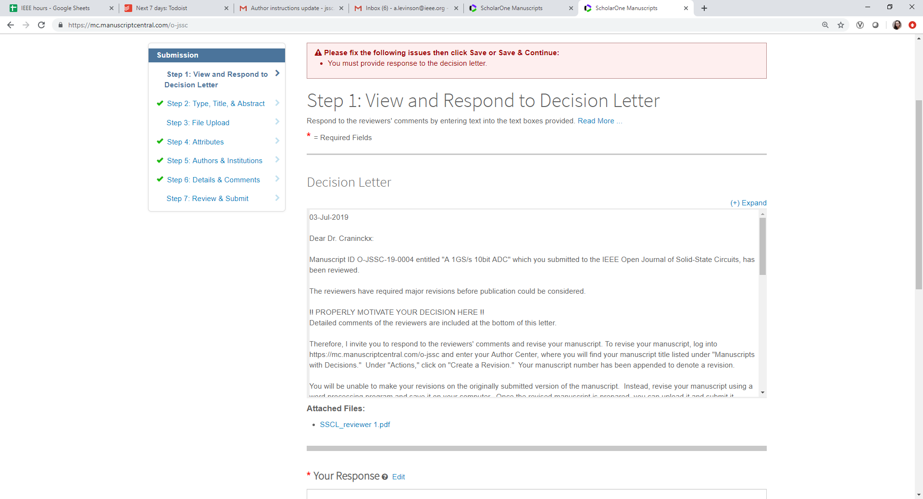
Continued…

Slide 35
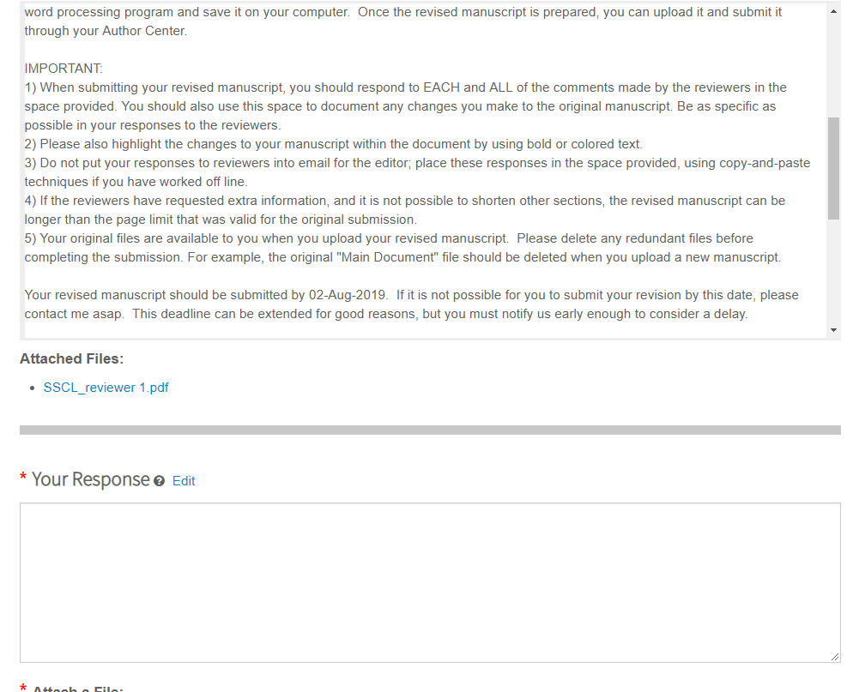
The response is preferable as a separate pdf file (details on how you responded to each review comment), text in this box can be "see attached file."

Slide 36
Detail how you address each and every of the reviewer comments in the text box provided
Highlight all changes in the revised manuscript with bold or colored text

Slide 37
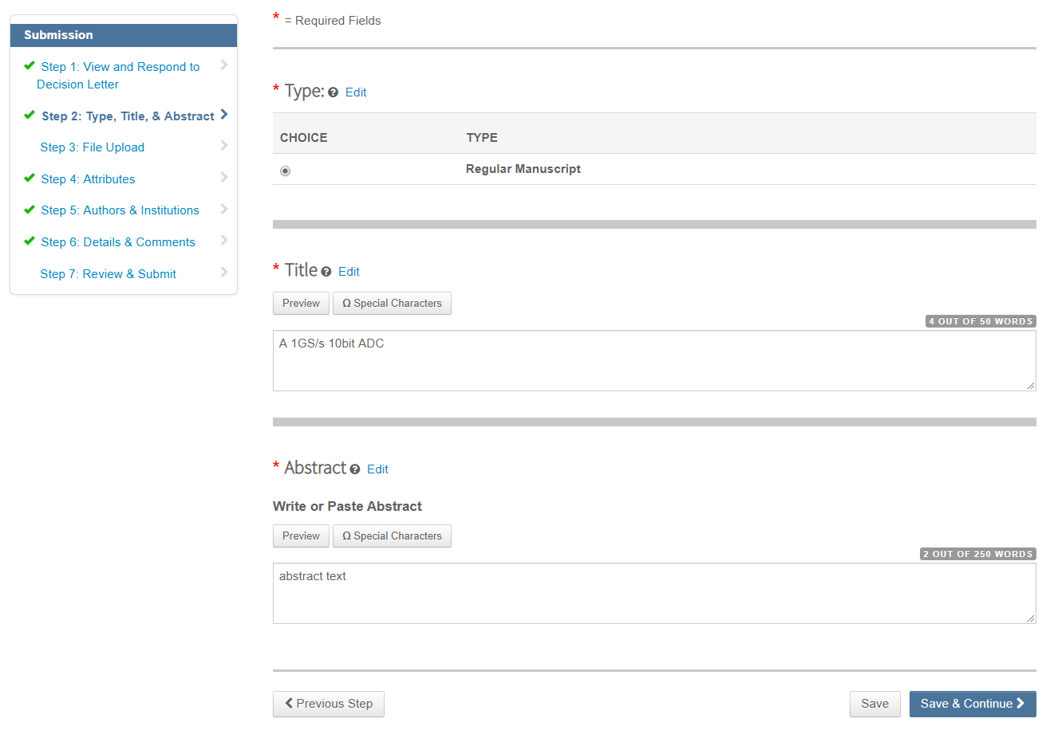

Slide 38
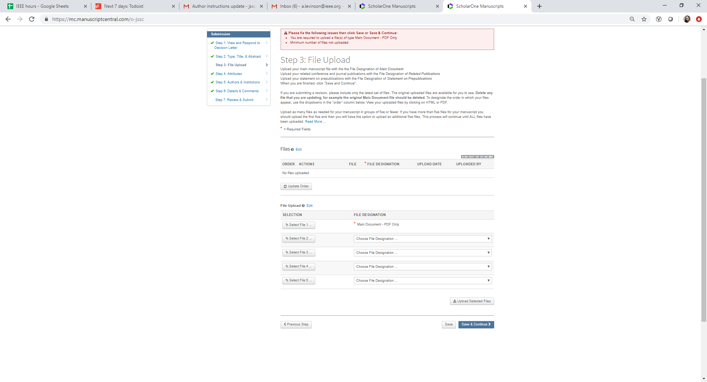
Minimum files required for upload:
* main revised
* revised manuscript with changes highlighted as a supplemental file for review
* reply to reviewer comments as a supplemnetal file for review
* prepublications if applicable

Slide 39
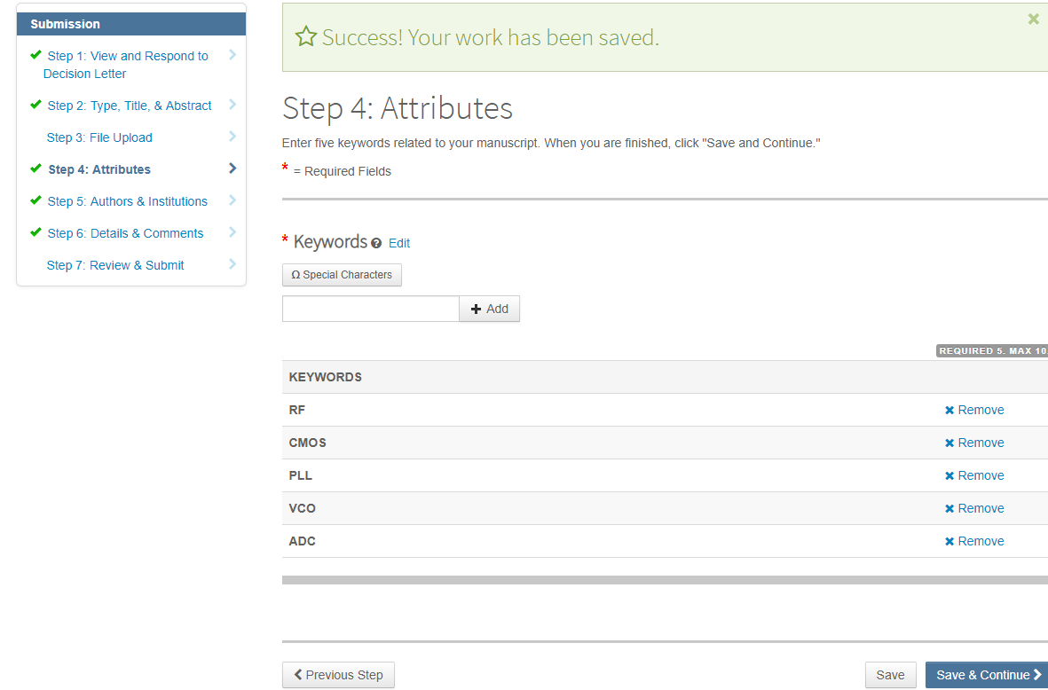

Slide 40
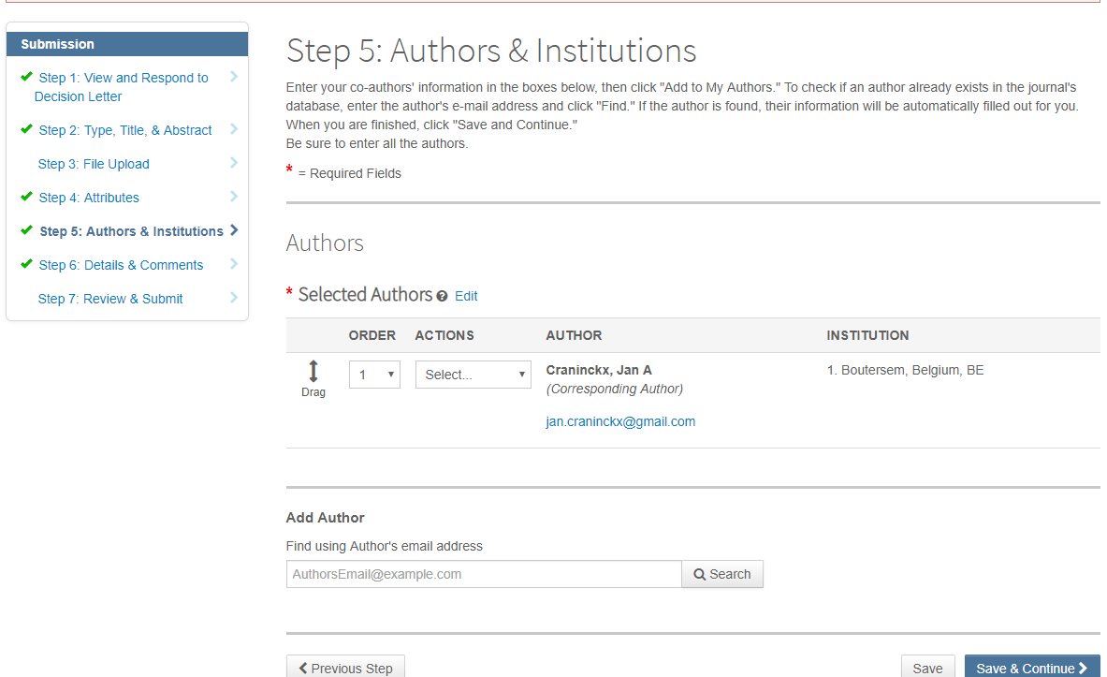
If there are any changes to the original author list, contact you AE and discuss/motivate the change!

Slide 41
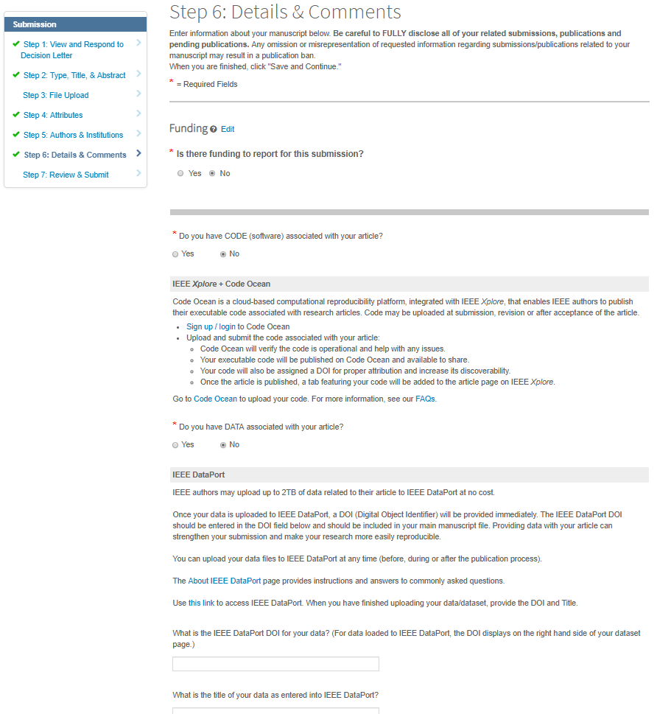
Continued…

Slide 42
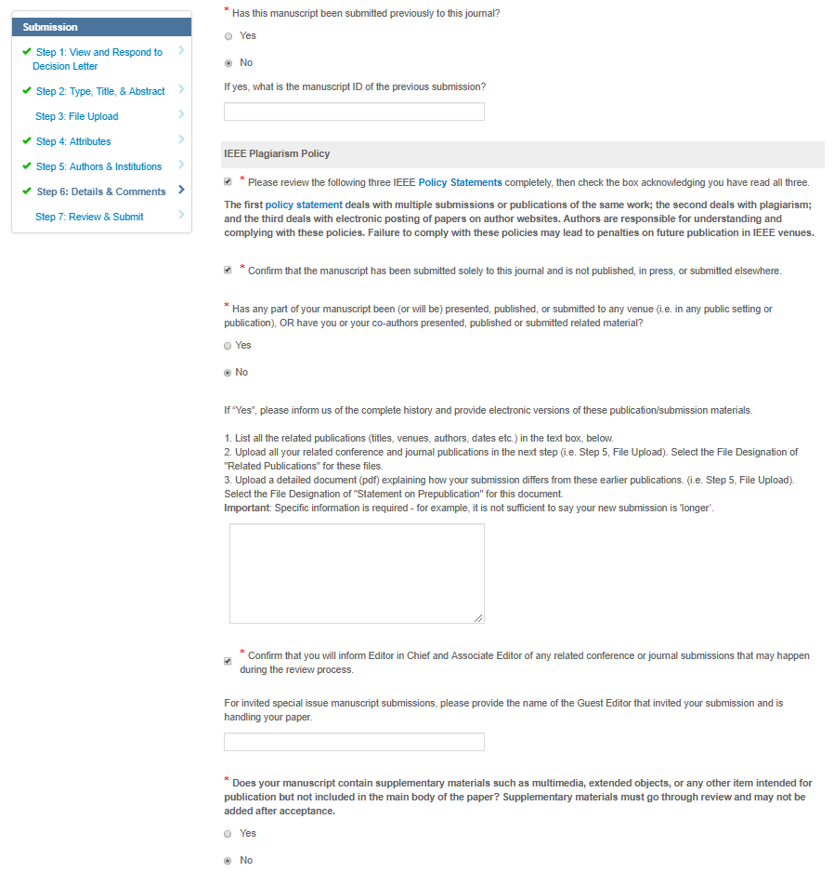
Update if any changes and notify your AE by email
Continued…

Slide 43
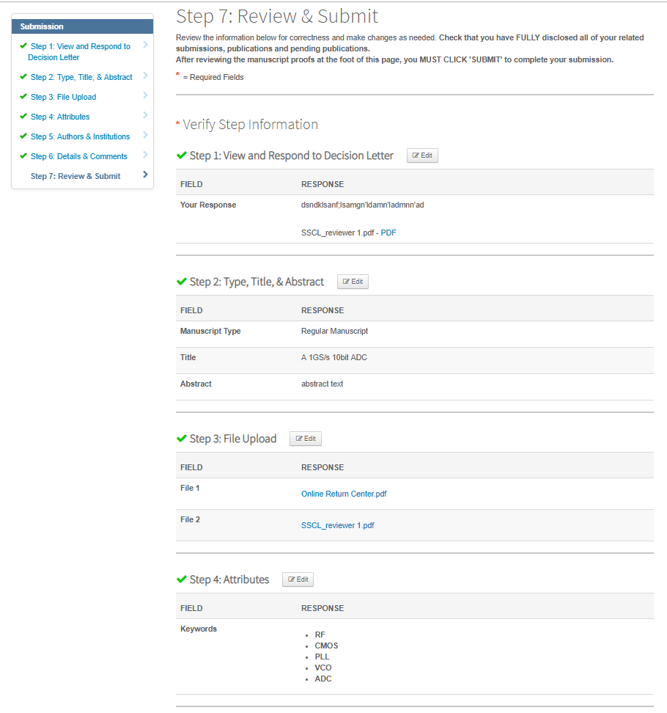
Continued…

Slide 44
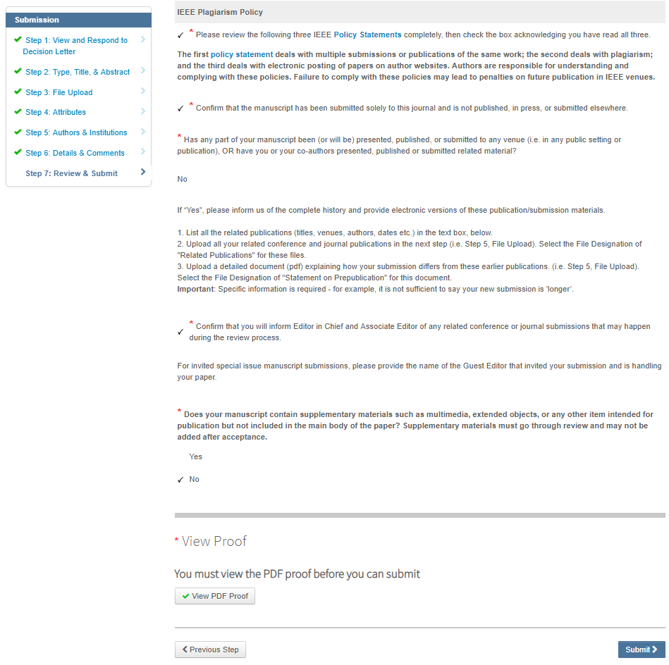
Check PDF and submit

Slide 45
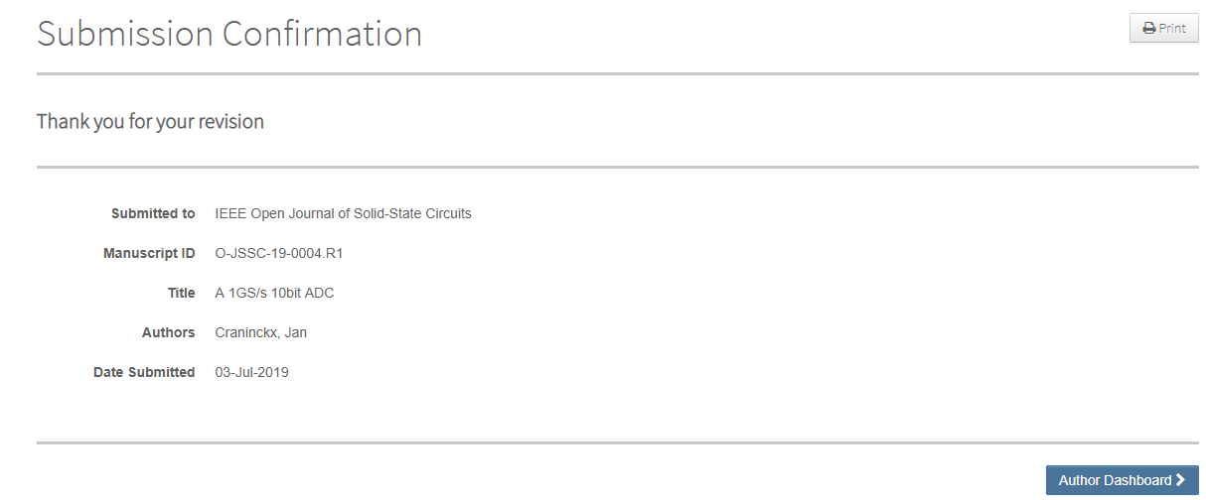
New Manuscript ID suffix

Slide 46
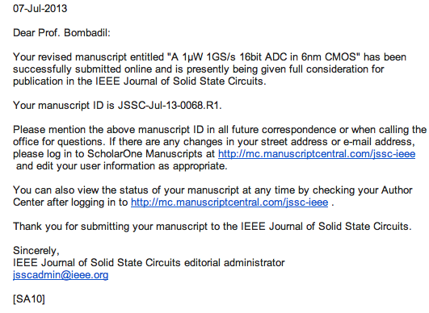
Confirmation email

Slide 47
Case 3: Paper Accepted

Slide 48
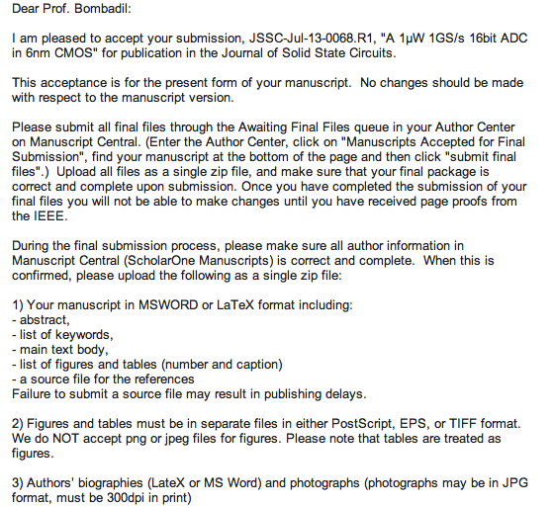
Example:
“Acceptance email”
Final Submission instructions
Continued…

Slide 49
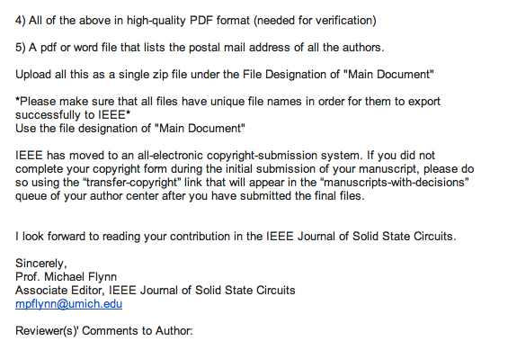

Slide 50
Carefully follow the instructions in the acceptance email
Upload the appropriate source and image files

Slide 51
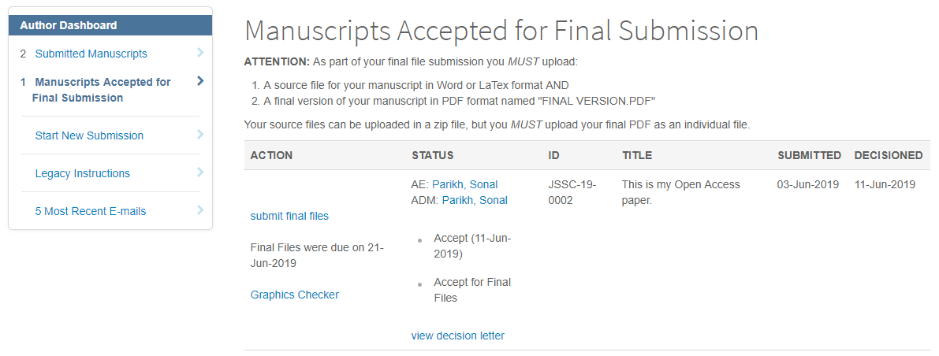


Slide 52
Six Steps to Submitting a Final Manuscript
Instructions & Reference Preview
File Upload
  -Upload all files as a single .zip file
Attributes
Authors & Institutions
Details & Comments
Review & Submit

Slide 53
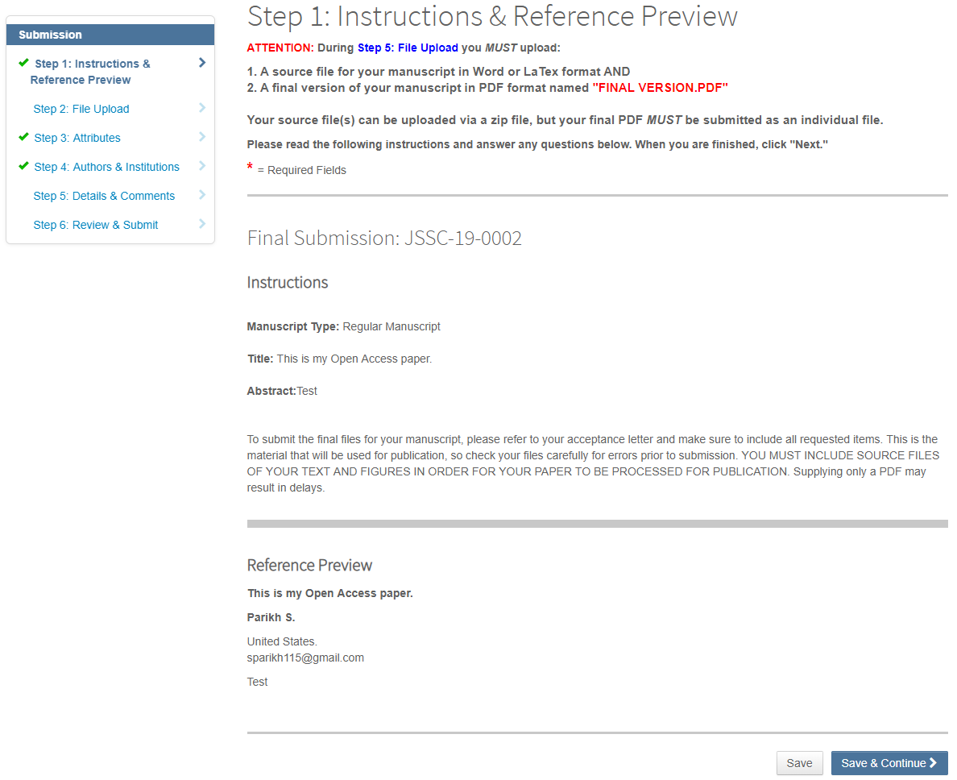

Slide 54
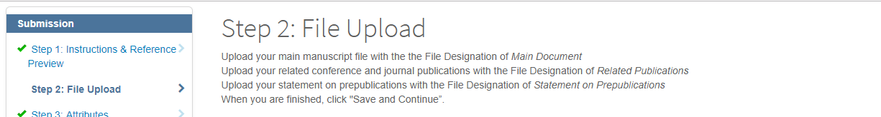
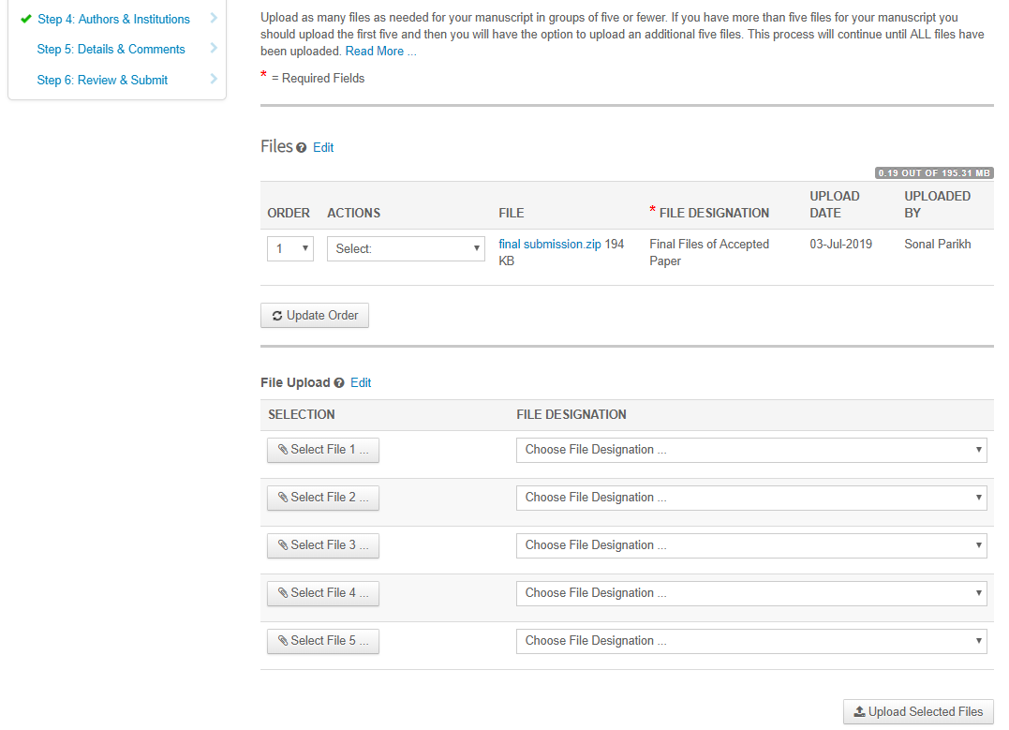
Upload a single zip file

Slide 55
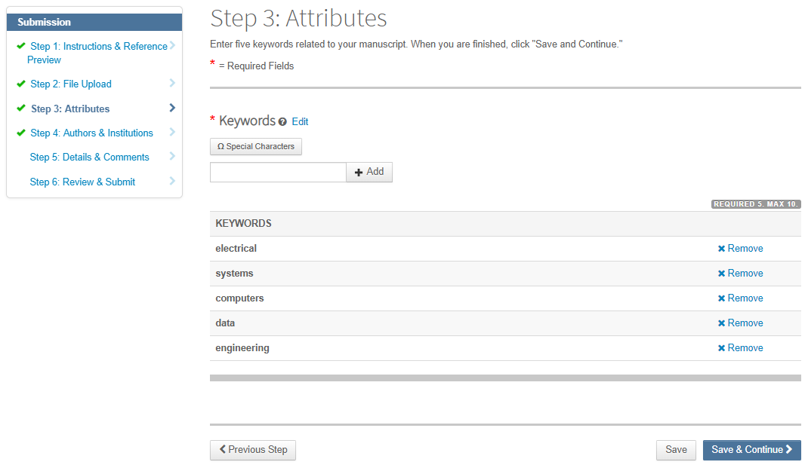
Update as needed and notify your AE by email of any changes

Slide 56
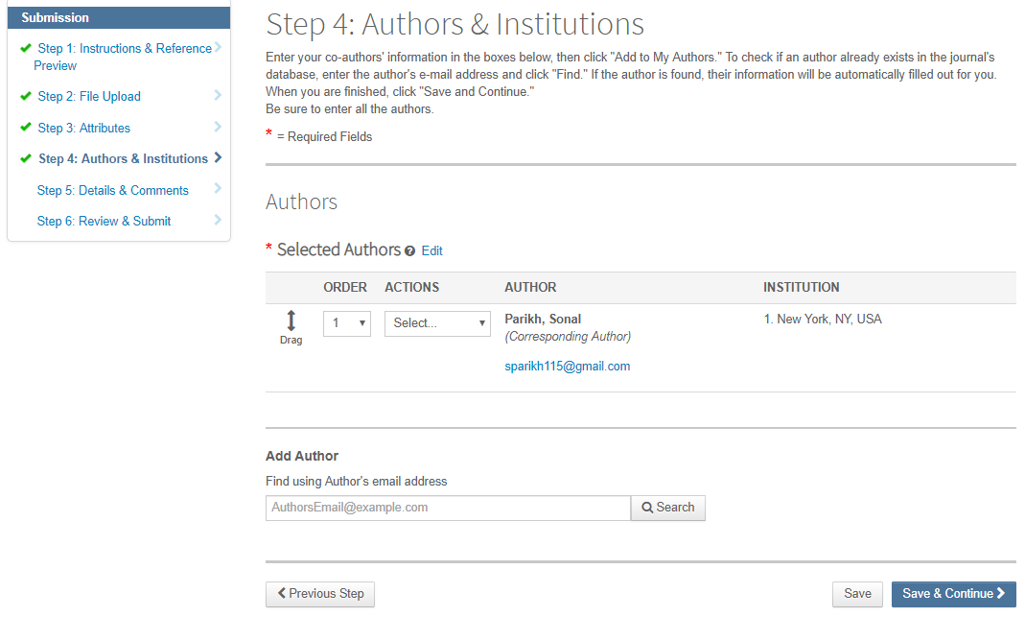
No changes to the author list are allowed at this point!

Slide 57
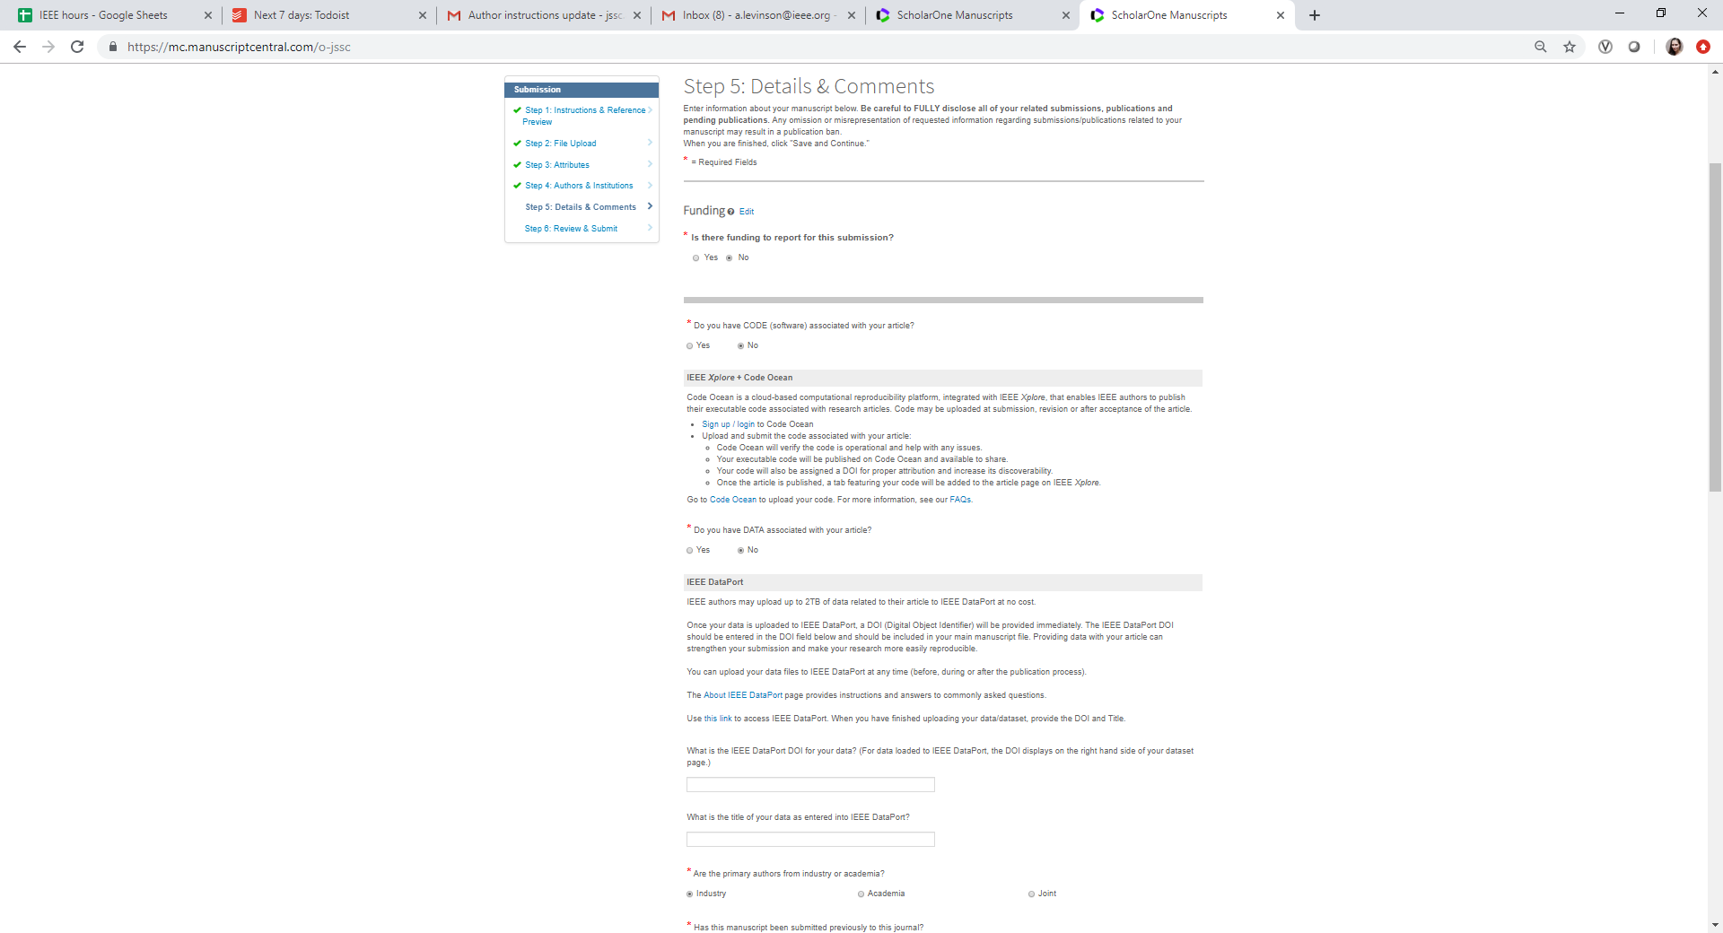
Consult with your AE if code or data must be included!
Update as needed
Continued…

Slide 58
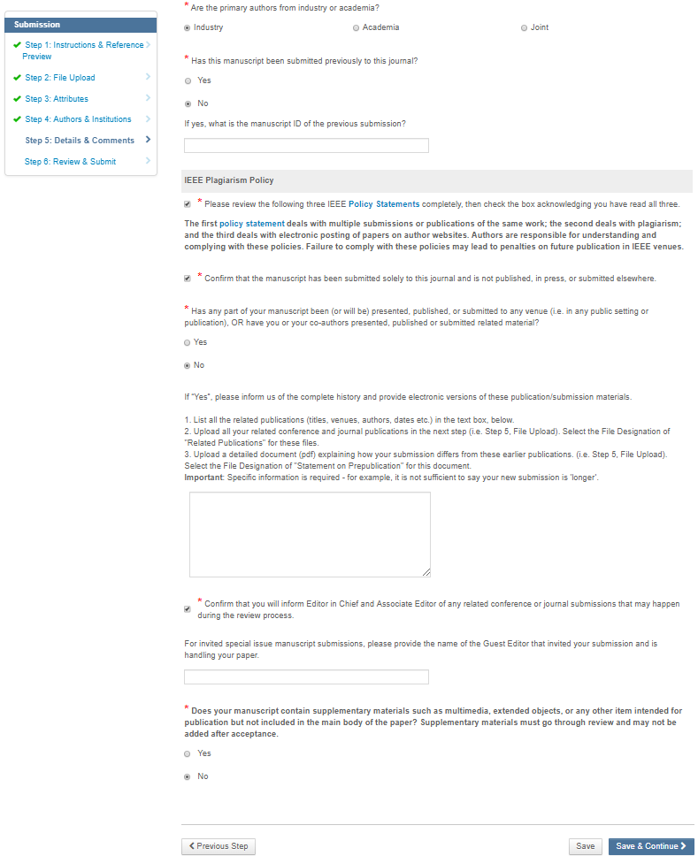
There should be no changes here at this point

Slide 59
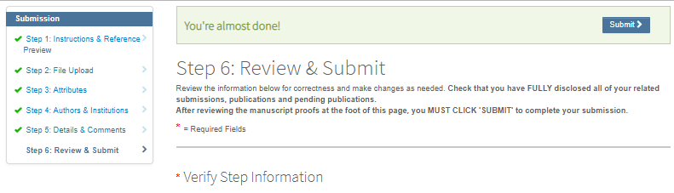
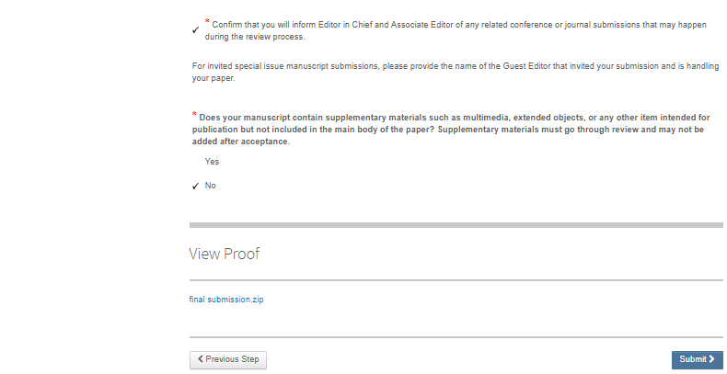

Slide 60
Confirmation email
August 6, 2019
Dear Dr. X,
The final files for JSSC-19-0318 have been successfully submitted to Manuscript Central.
The paper will now enter its production phase at IEEE publications in Piscataway, N.J. under the supervision of the IEEE production team. The publication date will depend upon the work flow of accepted papers and the issue-allotment of pages to JSSC. If there are any further changes to be made they will need to be made when you receive the final galley proofs from IEEE.
I look forward to reading your contribution in the IEEE Journal of Solid-State Circuits.
Sincerely,
Pavan Kumar Hanumolu
Editor in Chief, IEEE Journal of Solid State Circuits
jssc@illinois.edu

